Slide 1

Parkinson Disease Prediction
Parth Paliwal , Leyla Elnaggar, Suhail Shaikh, Vaishnavii Paramashivam

Slide 2
Introduction
PD causes vocal impairment that effects speech, motor skills, and other functions.
Tele_monitoring of the disease using voice measurement has a vital role in its early diagnosis of PD.

Slide 3
Dataset and objective
Dataset has biomedical voice measurements from 31 people of which 23 has Parkinson disease(PD).
01
Each column corresponds to a particular voice measure and each row corresponds to 195 voice recording from those individuals.
Dependent variable is status column ( Binary variable 0/1 with 0 for healthy and 1 has PD)
02
Objective:
- To discriminate or identify healthy people from those with PD.
- Identify the key predictors in speech-related characteristics to PD
03

Slide 4
Data Exploratory analysis
Independent variables are linear variables
MDVP:Fo(Hz) - Average vocal fundamental frequency MDVP:Fhi(Hz) - Maximum vocal fundamental frequency MDVP:Flo(Hz) - Minimum vocal fundamental frequency
MDVP:Jitter(%),MDVP:Jitter(Ab),MDVP:RAP,MDVP:PPQ, Jitter:DDP - Several measures of variation in fundamental frequency
MDVP:Shimmer,MDVP:Shimmer(dB),Shimmer:APQ3, Shimmer:APQ5,MDVP:APQ,Shimmer:DDA - Several measures of variation in amplitude
NHR, HNR - Two measures of ratio of noise to tonal components in the voice
RPDE, D2 - Two nonlinear dynamical complexity measures
DFA - Signal fractal scaling exponent
spread1, spread2, PPE - Three nonlinear measures of fundamental frequency variation
Dependent Variable :status - Health status of the subject (one) :has Parkinson's, (zero) : Healthy Person

Slide 5
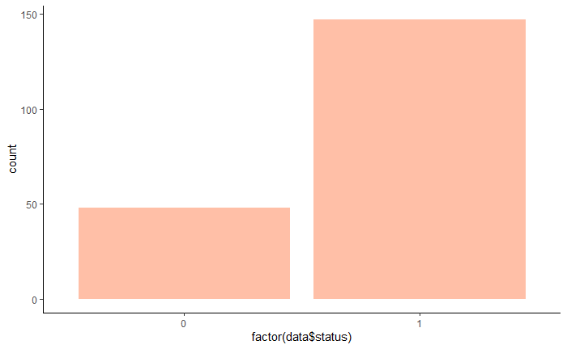
Data distribution
We have more healthy people in our dataset
Dataset is relatively small with 195 observations, which might lead to overfitting

Slide 6
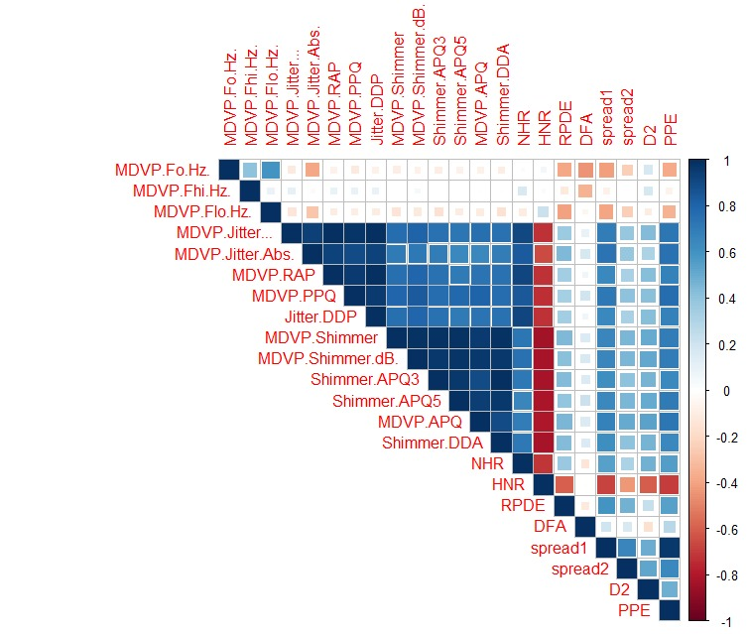
Correlation graph
This graph shows correlation between independent variables.
MDVP(hi,lo,O) have low correlation/uncorrelated with all other voice measurments.
RPDE,DFA,Spread2,D2 have also low correlation with all other IV.
HNR (noise)has negative correlation with most IV.

Slide 7
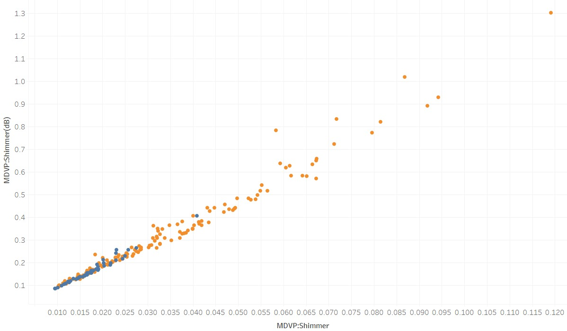
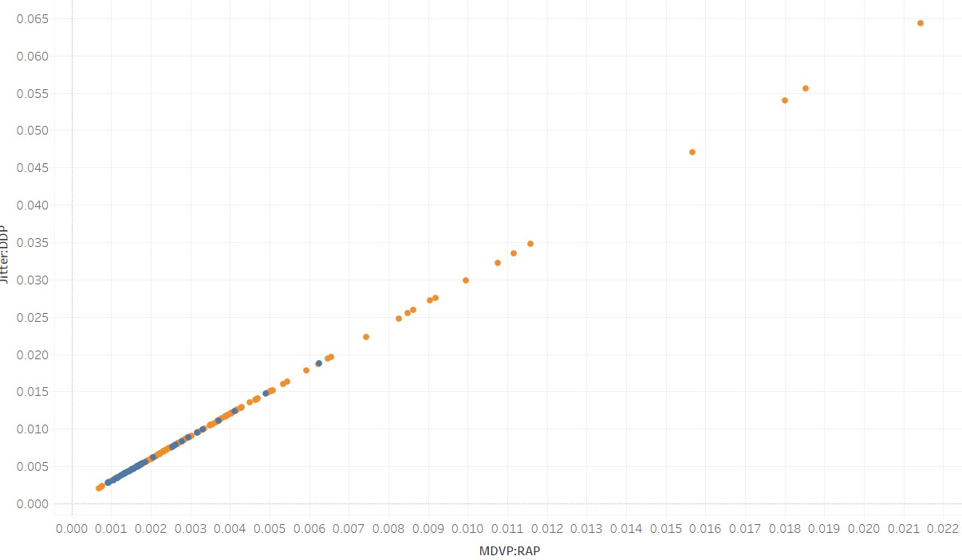
Independent variables plotting: we have plotted dome of the highly correlated variables MDVP:Shimmer(dB) & MDVP:SHIMMer
MDVP:RAP & Jitter:DDp

Slide 8
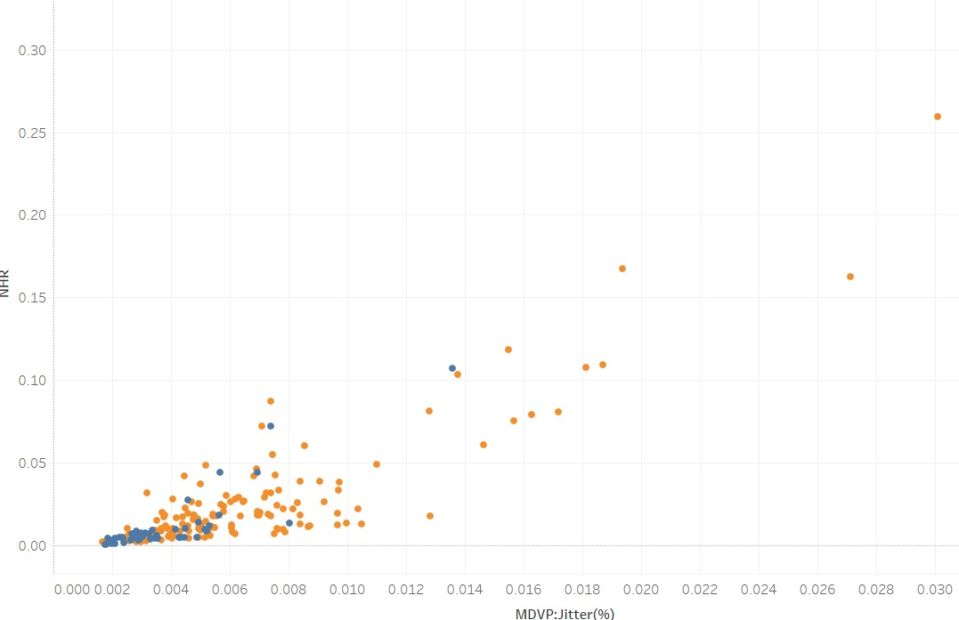
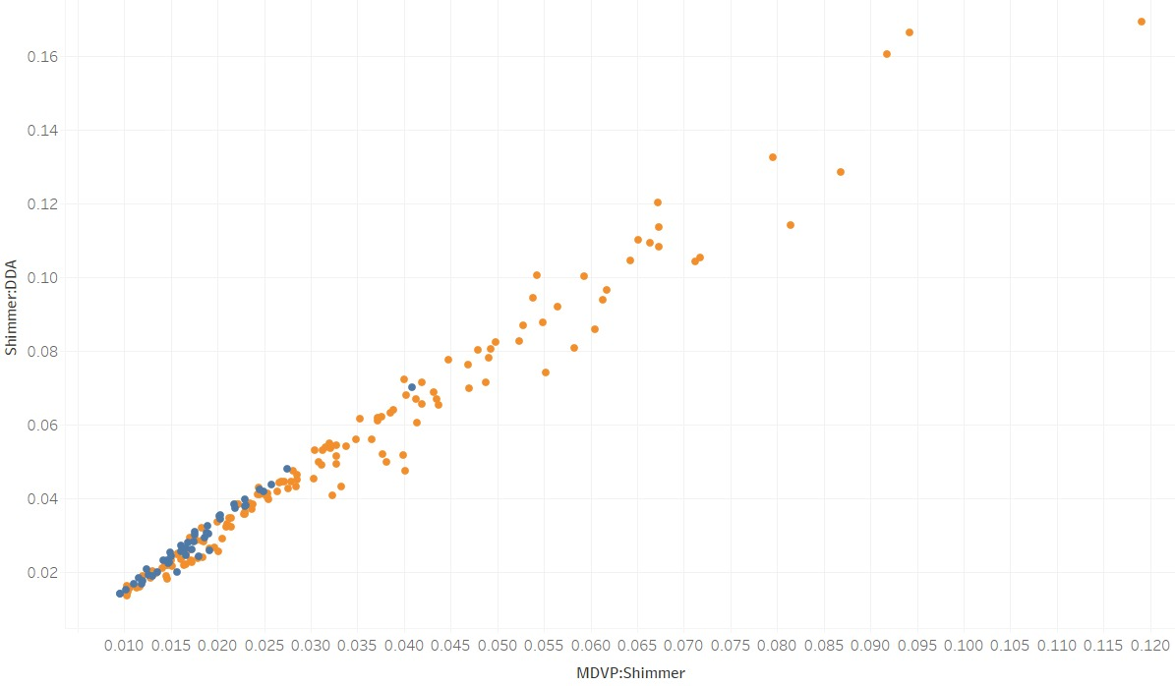
Shimmer:DDA & MDVP:Shimmer

Slide 9
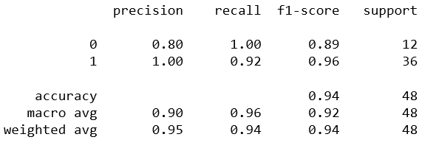
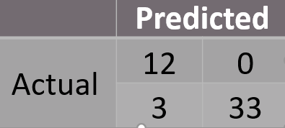
Regularized Logistic Regression
Lasso Regression:
Used Lasso Regression to obtain subset of predictors by shrinking regression coefficients for some predictors to zero.

Slide 10
Coefficients
For Regularized Logistic Regression model the Interpretation of Coefficients is as follows:
Predictor | Coefficients | Odds | Interpretation
MDVP:Fo(Hz) | -0.00928 | 0.990762926 | 1 Unit increase in 'MDVP:Fo(Hz)' decreases odds of having Parkinson disease by 1 %
MDVP:Shimmer(dB) | 2.5805 | 13.20373838 | 1 Unit increase in 'MDVP:Shimmer(dB)' increases odds of having Parkinson disease by 13 times
HNR | 0.1627 | 1.176683632 | 1 Unit increase in 'HNR' increases odds of having Parkinson disease by 17 %
spread1 | 1.3957 | 4.037800044 | 1 Unit increase in 'spread1' increases odds of having Parkinson disease by 4 times
D2 | 3.38108 | 29.40250868 | 1 Unit increase in 'D2' increases odds of having Parkinson disease by 29.4 times

Slide 11
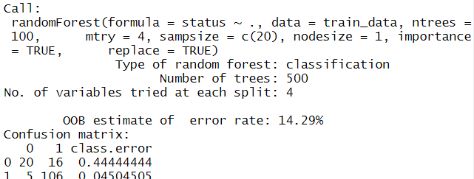
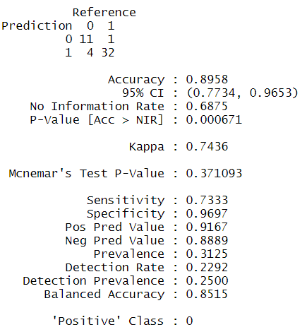
Random Forest
Training Data was split into 2 sets with 75:25 ratio.
The split was made based on target variable to ensure PD affected rate remains the same in the 2 sets.
Parameter Tuning by checking accuracy on Testing Set resulted in best parameters as:
Number of Trees: 100
Number of predictors to choose(mtry) = 4
Testing Accuracy of 89.6% was best scenario on 48 Testing subjects.

Slide 12
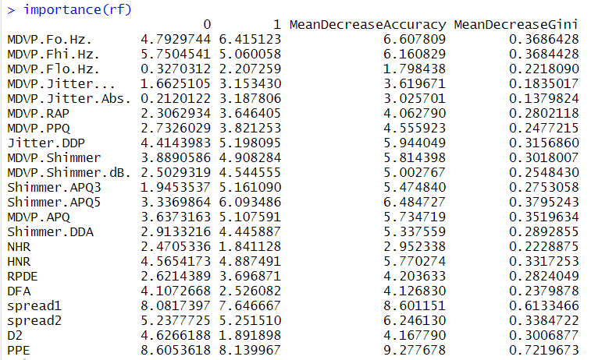
Random Forest
MeanDecreaseAccuracy shows us that the more the accuracy of the random forest decreases due to the exclusion of a single variable, the more important that variable is deemed.
Important Factors:
MDVP:Fo(Hz)
MDVP:Fhi(Hz)
Shimmer:APQ5
Spread1
PPE
Spread2
Jitter:DDP

Slide 13
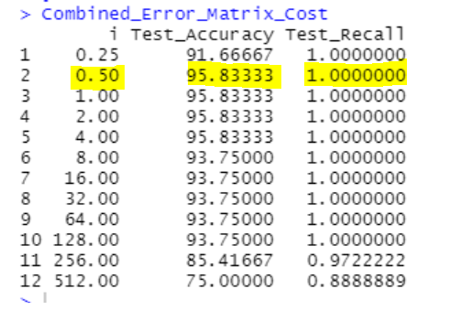
Support Vector Machines
The data was split into training(24 people) & test (8 people)
Data was checked if linearly separable using the following methods:
Data Visualization – Pair plots
Perceptron Algorithm (Accuracy of 87.17%)
Linear Kernel with C=very high or infinity (Accuracy of 85.12%)
SVM with linear kernel was used to train the model
Accuracy and Recall were calculated for a range of cost values and accordingly the best cost value was found to be 0.5

Slide 14
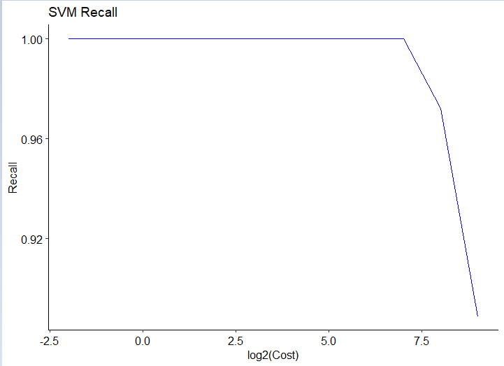
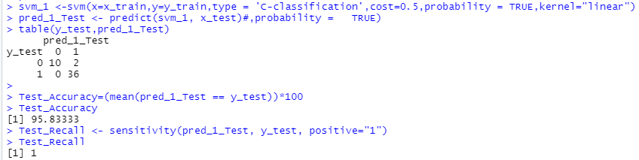
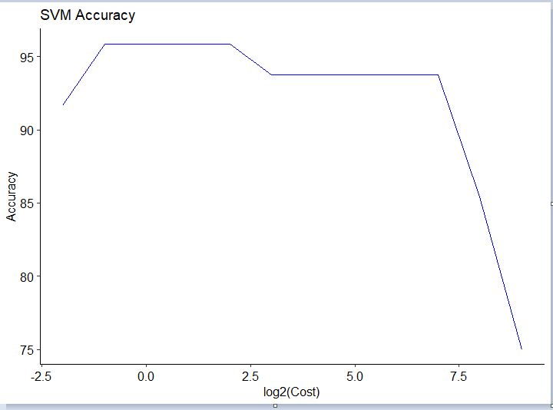
Support Vector Machines
Model Output:

